Slide 1



DATA ANALYST ONBOARDING JOURNEY
Structured Learning & Capability Development Framework
Internal Learning Program | 2026

Slide 2


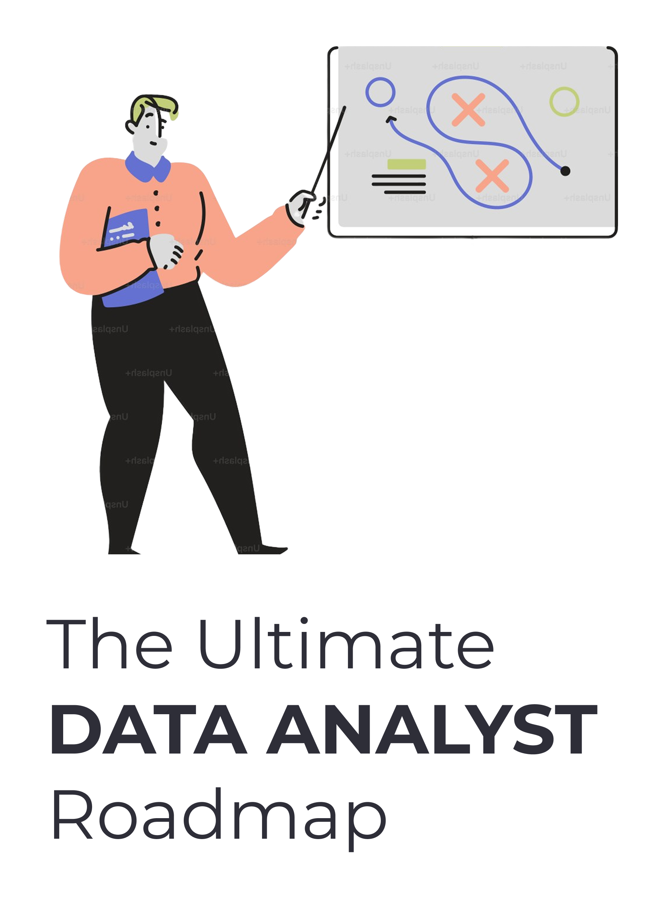
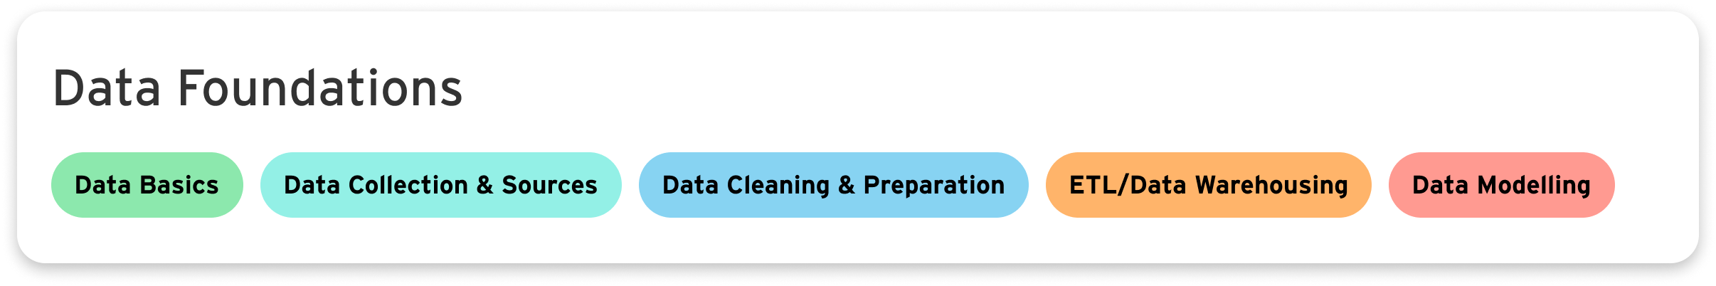
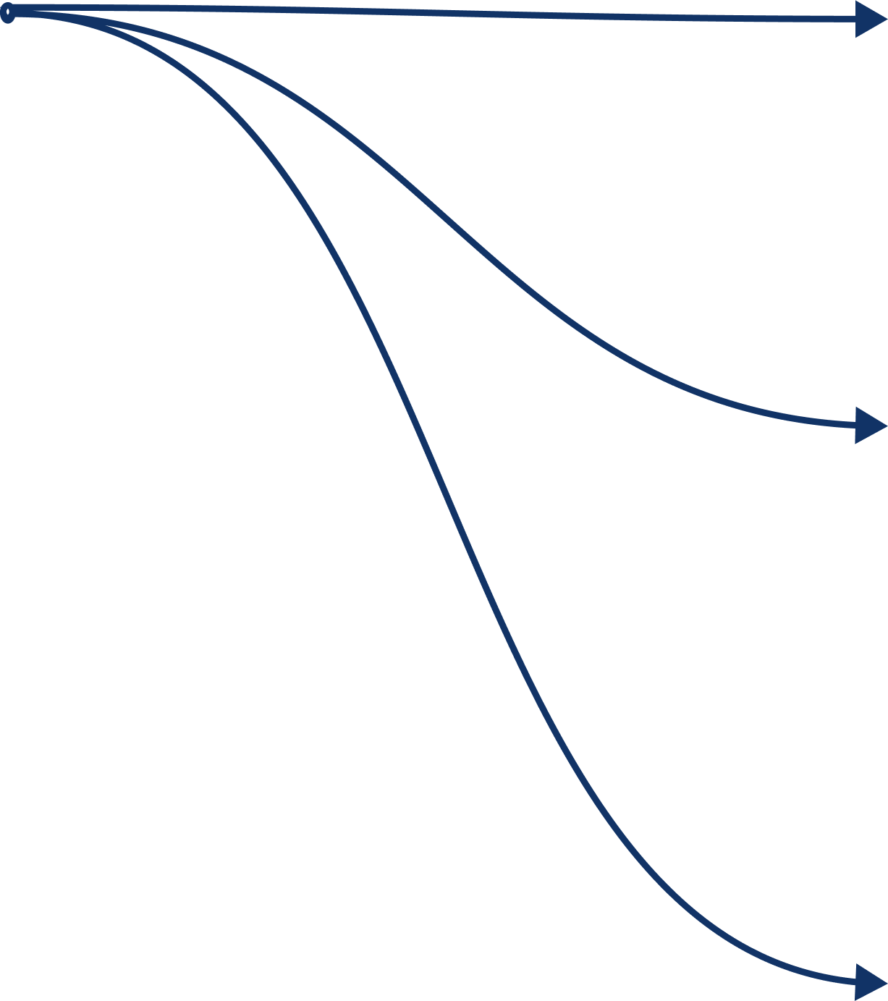
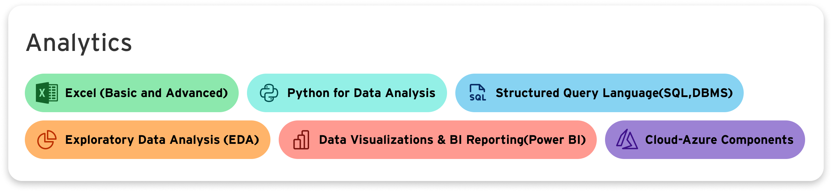
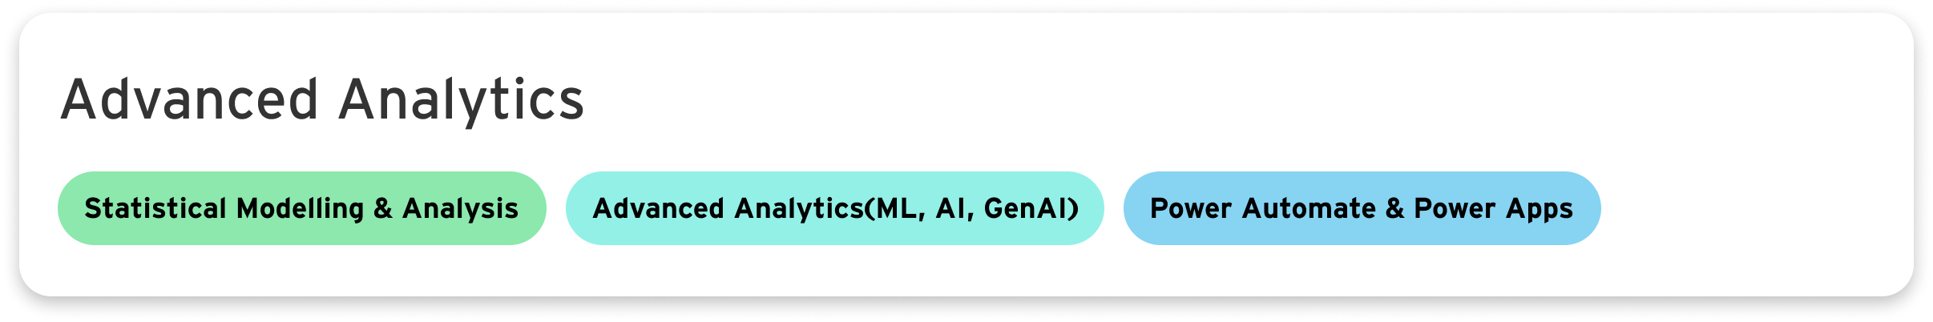

Slide 3

01.
DATA FOUNDATIONS
Build essential data handling, storage, and management skills.
LEARNING FRAMEWORK OVERVIEW
ANALYTICS
Structured onboarding framework
02.
Data analysis & visualization
Tools: SQL, Python, Excel, Power BI
Covers end-to-end analytics skills
Combines theory, tools, and hands-on learning
ADVANCED ANALYTICS
03.
Explore statistical modelling, machine learning, AI, and automation with Power Automate & Power Apps.

Slide 4


PHASE 1: DATA FOUNDATIONS
Focus: Build strong data handling and preparation skills
Data Basics
Data Collection & Sources
Data
Cleaning & Preparation
ETL/Data Warehousing
Data Modelling
01
Curated resources mapped to each module for a structured learning experience
Video
Reading
Written
Certification

Slide 5


Introduction to Data Literacy
1.1 BUILD FOUNDATIONS
DATA FOUNDATIONS: DATA INFRASTRUCTURE & MANAGEMENT
Data Quality Management
Basics Of Data Analytics
(Core data handling processes to manage, store, and prepare data for analysis)
Data Analyst Bootcamp

Slide 6
Data Collection
1.2 DATA COLLECTION & DATA SOURCES
COLLECTION
Data Collection Sources
Understanding Data Sources & Collection Methods Systematic process of gathering information from primary
Data Collection – Methods Types and Examples

Slide 7
Data Cleaning
Data Cleaning Tasks
1.3 DATA CLEANING & PREPARATION
Data Cleaning in Data Mining
CLEANING
Cleaning and Preparing Data for Analysis
Preparing Data for Analysis. Foundational step for machine learning and business intelligence
Data Cleaning &
Preprocessing
5 Essential Data Preprocessing Techniques

Slide 8
ETL
ETL Process in Data Warehouse
1.4 ETL/ DATA WAREHOUSE & DATA MODELLING
Data Warehouse Fundamentals for Beginners
MODELLING
Structuring and Managing Data Efficiently. Ensure data is cleaned, integrated, and organized
Mastering Data Modelling Fundamentals
Data Warehouse - The Ultimate Guide

Slide 9



PHASE 2: DATA ANALYTICS
Focus: Transform data into actionable insights
Excel (Basic and Advanced)
Python for Data Analysis
Structured Query Language (SQL,DBMS)
Exploratory Data Analysis (EDA)
Data Visualizations & BI Reporting(Power BI)
Cloud-Azure Components
02
Curated resources mapped to each module for a structured learning experience
Video
Reading
Written
Certification

Slide 10

Microsoft Excel - Excel from Beginner to Advanced
2.1 EXCEL (BASIC AND ADVANCED)
Unlock Excel VBA and Excel Macros
DATA ANALYSIS & AUTOMATION
(Transforming data into actionable insights through statistical analysis and visualization)
Excel Power Query
Excel Practice Online

Slide 11
Python
Python for beginners
2.2 PYTHON
PROGRAMMING FOR DATA ANALYSIS
Python for Data Science
Analyze and process data using scalable and efficient programming workflows.
Python for Data Analysis & Visualization
Python Practice HackerRank

Slide 12
SQL Tutorials (W3 Schools)
SQL Query Optimization
2.3 STRUCTURED QUERY LANGUAGE (DBMS)
MySQL For DA and BA
DATA QUERYING & MANAGEMENT
SQL Interview Questions
Extract, manage, and manipulate structured data from relational databases.
Advanced SQL Server Masterclass
Practice Top 50 SQL Questions

Slide 13
Exploratory Data Analysis
2.4 EXPLORATORY DATA ANALYSIS (EDA)
Steps for Mastering Exploratory Data Analysis
INSIGHT DISCOVERY & PATTERN ANALYSIS
EDA and its Types
Identify trends, patterns, and anomalies through statistical exploration and visualization.
EDA in Data Science: Types & Tools

Slide 14
Data Visualization
Power Query - Power BI
2.5 DATA VISUALIZATIONS & BI REPORTING
Microsoft Power BI Desktop for Business Intelligence
POWER BI
Generate DAX Function using Chat GPT & Co-pilot
Build interactive dashboards to communicate insights and support decision-making.
Power BI DAX - Complete Playlist
Microsoft Power BI Data Analyst Associate Certification

Slide 15
Microsoft Azure Fundamentals Course
DP-900 Microsoft Azure Data Fundamentals Certification
2.6 CLOUD – AZURE COMPONENTS
AZ-900: Microsoft Azure Fundamentals Certification - 2025
CLOUD DATA & ANALYTICS PLATFORM
Microsoft Certified: Azure Fundamentals
Utilize cloud services for data storage, processing, and advanced analytics.
Microsoft Azure Data Fundamentals
Microsoft Certified: Azure Data Fundamentals

Slide 16

PHASE 3: ADVANCED ANALYTICS
Focus: Enable predictive insights and automation-driven decision making
Statistical Modelling & Analysis
Advanced Analytics(ML, AI, GenAI)
Power Automate & Power Apps
03
Curated resources mapped to each module for a structured learning experience
Video
Reading
Written
Certification

Slide 17

3.1 STATISTICAL MODELING & ANALYSIS
Statistics for Data Science and Business Analysis
PREDICTIVE INSIGHTS & DATA MODELING
Predictive Analytics
Apply statistical techniques to identify patterns and forecast future trends.

Slide 18
Complete Data Science, Machine Learning,DL,NLP Bootcamp
3.2 ADVANCED ANALYTICS: ML, AI, GEN AI
INTELLIGENT DATA-DRIVEN SOLUTIONS
Generative AI for data analytics
Build models and leverage AI to automate insights and enhance decision-making.
Generative AI for Beginners

Slide 19
PL-900: Microsoft Power Platform Fundamentals Course
3.3 POWER AUTOMATE & POWER APPS
PROCESS AUTOMATION & LOW-CODE SOLUTIONS
Microsoft Certified: Power Platform Fundamentals
Design automated workflows and applications to improve efficiency and scalability.
Power Apps Course - Basic to Advanced

